Slide 1
Mitosis vs Meiosis

Slide 2
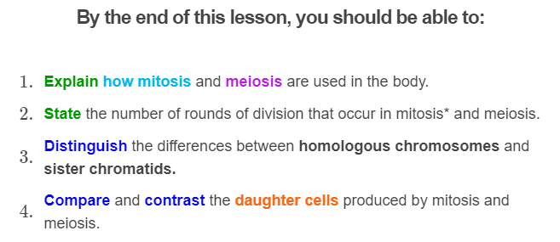
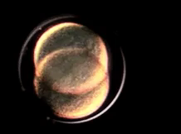

Slide 3

Meiosis and mitosis are both types of cell division.
They are pretty similar and can be confusing, so here is a quick comparison of the two types of cell division.

Slide 4
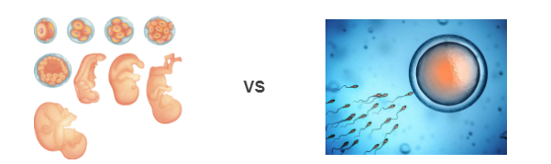
Mitosis and meiosis both make new cells, but for different purposes.
Mitosis is used for growth and recovery from injury or illness.
Meiosis is used to make gametes for sexual reproduction.

Slide 5
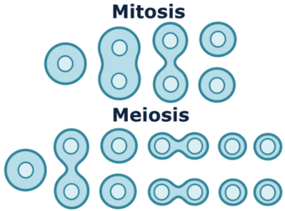
Many of the steps in mitosis and meiosis are similar.
However, meiosis has a couple of extra steps. There are 2 rounds of cell division in meiosis, but only 1 in mitosis.

Slide 6
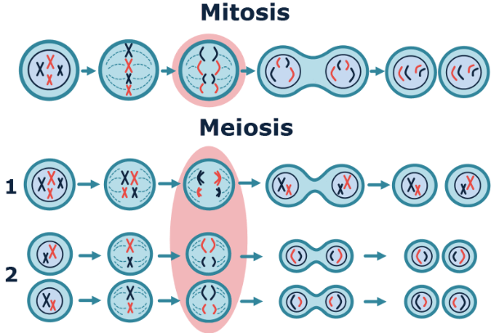
It is important to be able to distinguish between homologous chromosomes and sister chromatids!
In meiosis, the homologous chromosomes are separated in the first round of cell division, and the sister chromatids in the second.
In mitosis, only the sister chromatids are separated.

Slide 7
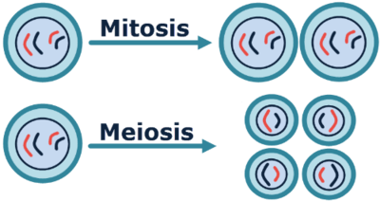
The two rounds of cell division produce four haploid daughter cells in meiosis.
Mitosis, which only undergoes one round of cell division, produces two diploid daughter cells.

Slide 8
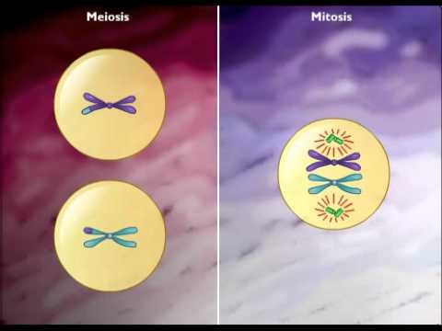

Slide 9


Overall, the most important things to remember are:
Mitosis is important for growth and recovery. It makes 2 genetically identical, diploid daughter cells.
Meiosis is important for sexual reproduction. It makes 4 genetically different, haploid daughter cells.

